Slide 1




Unlocking The Archive
A History of the archive ??

Slide 2
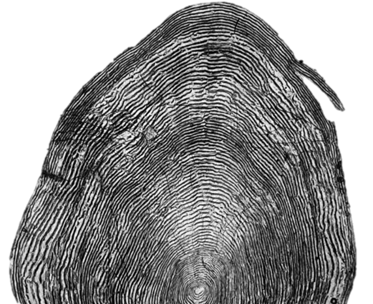
Unlocking The Archive
Where did it originate ?
Whats in it ?
Stimulate discussion on:
What more can we do with it ?
Novel uses (Genetics, Scale chemistry etc ?

Slide 3
Where did it originate from ?
1930’s to 60’s
Salmon Fisheries collections - Arthur Went
Age and growth, longevity, biological characteristics
1950’s to 70’s
Salmon fisheries and experimental collections (e.g. liming acidic waters to enhance salmon juvenile growth - Eileen Twomey

Slide 7
“When dealing with the investigations of salmon of other Irish River's …. could be divided into natural groups, namely, one group containing those fish which showed their scales more than two new rings of growth in fresh water in the spring prior to migration as a smolt, termed for convenience, type B smolts; and a second group which showed little or no growth in fresh water in the spring prior to migration as a smolt, termed type A smolts”

Slide 8
Scale collection, cleaning, mounting, reading and analyses are time consuming so regular use of scales and there collection declined throughout the 80’s and 90’s

Slide 9
Intercirculi distances
Circuli count

Slide 11
Recruitment is strongly linked to growth described as the total number of circuli but not to inter-circuli distances.
Highlighted the potential of patterns of circuli number to be considered as proxies of growth.
Indicated that hatchery populations might be subject to other mortality events in addition to those experienced by wild fish.

Slide 13
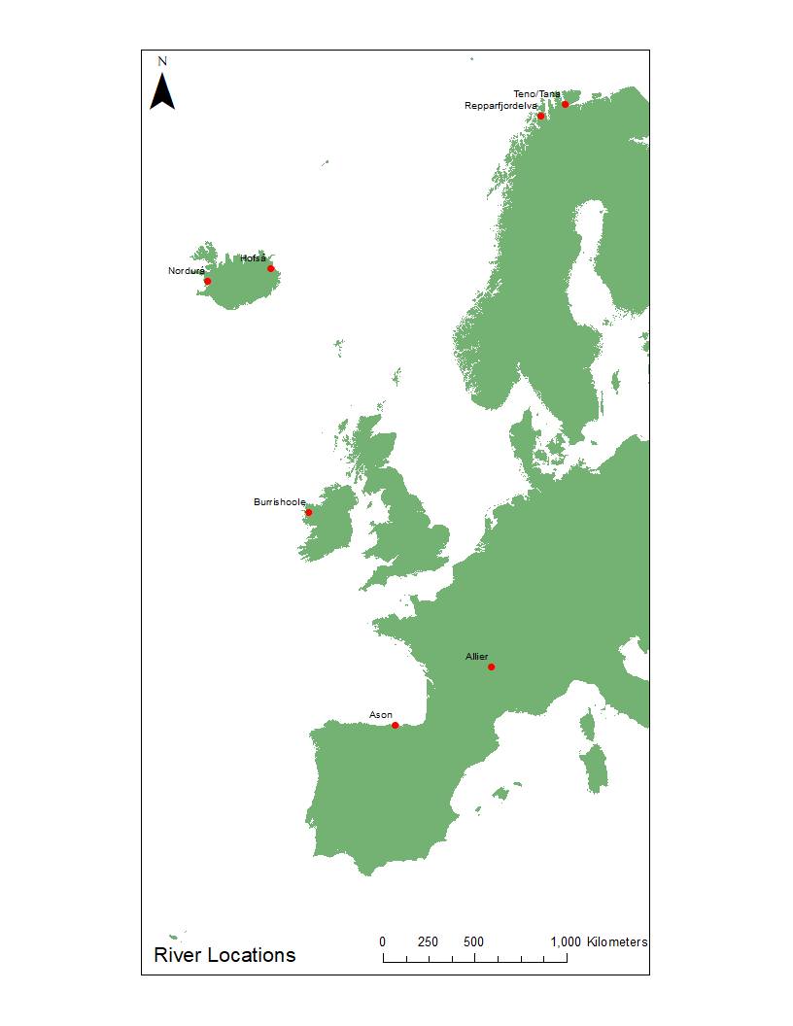
Additional Rivers
Country | River | Period | Years (n) | Samples analysed
Norway | River Repparfjordelva | 1932, 35-38, 40, 42-44, 46-48, 55, 59-2008 | 63 | 4080
Finland | River Teno/Tana (dataset 1) | 1939, 72-2005 | 35 | 11565
 | River Teno/Tana (dataset 2) | 1976-78, 81, 86-88, 91, 96-98, 01, 06-08 | 15 | 1415
Iceland | River Nordurá | 1988-2008 | 21 | 1956
 | River Hofsá | 1987-2008 | 21 | 1741
Ireland | River Burrishoole | 1968-2008 | 47 | 2200
France | River Allier | 2008-2010 | 3 | 52
Spain | River Ason | 2000, 02-03 | 3 | 55

Slide 15
As suggested by Peyronnet et al. (2007, 2008) and Friedland et al. (2009), scale growth appears to be a proxy for survival/recruitment in this study.
However, while consistent relationships were shown for the Burrishoole and Nordurá, it is less clear for the other rivers.
The lack of temporal synchrony between these rivers, which are widely located geographically, may suggest very different post-smolt feeding areas which are influenced by different oceanic conditions and biological parameters.
Growth is, however, clearly linked to oceanic conditions (either SST or NAO or both) for all rivers.
Further investigation is also warranted to identify key periods and locations where these factors influence growth rates specifically as this could provide insights into how fish from different geographic origins are influenced by broader oceanic conditions.

Slide 16
Chapter 5.
Decadal changes in post-smolt growth in three Irish populations of Atlantic salmon (Salmo salar L.).
Submitted to the Higher Education and Training Awards Council, September 2018

Slide 18
Scale growth measurements and their temporal trends varied between populations, with a most notable decline evident in the Burrishoole river.
Correlations between scale growth measurements and oceanographic variables sea were noted .
i.e. Post-smolt scale growth and circuli number were negatively correlated with SST in the Burrishoole and Moy rivers, NAO in the Burrishoole river and AMO in the Burrishoole and Shannon rivers.
Broad scale decadal decreases in growth rates which correspond to reported declines in return rates of Atlantic salmon were evident across populations and the results indicate that trends observed in one national index river may be representative of change across all populations

Slide 19
Where did it come from ?
1930’s to 60’s
Salmon Fisheries collections - Arthur Went
1950’s to 80’s
Salmon fisheries and experimental collections - Eileen Twomey , John Browne
1980’s to present
National Coded Wire tagging programme random samples- John Browne, NÓM
Used for splitting national catch for mandatory reporting to ICES/NASCO

Slide 20
Original Archive in Cathal Brugha Street ( Dept. of Fisheries)
Moved to FRC Abbotstown
Storage was ad hoc in cupboards, under desks.
Eventually moved to outside portacabins. These portacabins became unuseable after time and scale collection and storage boxes were in a bad state of decay.
Efforts were then made to clean and rebox the collection.
Collection was transported to Newport but still needed cleaning and reboxing:
Several elements in the Archive i.e. mounted scales (shown)

Slide 21
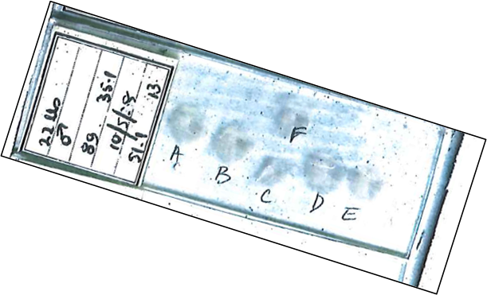
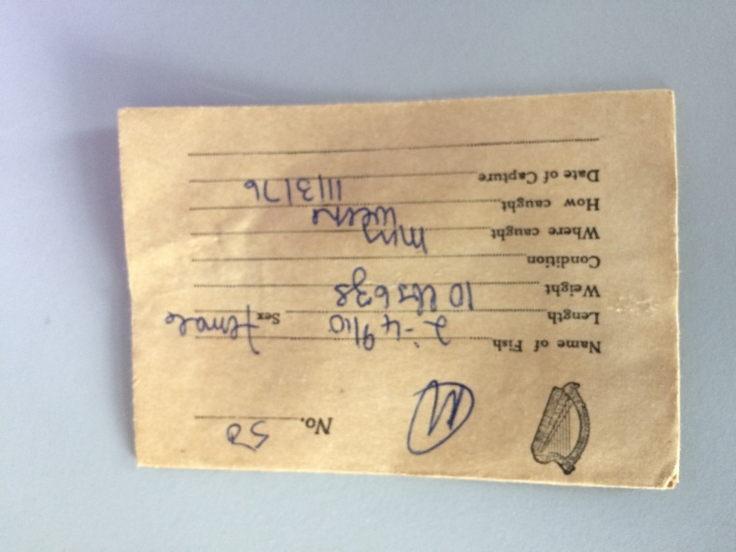
Rolled acetates
Scale envelopes

Slide 22
River | Years | Status | No. years | No of samples | No. per year
Burrishoole River | 1964 to 2008 | Envelopes/Mounted/Rolled | 40 | 462 | 12
Corrib River | 1960- 2008. | Envelopes/Mounted/Rolled | 49 | 565 | 12
Erne River | 1927, 1928, 1952, 1958, 1969 - 1971, 1980 to 2008. | Envelopes/Mounted/Rolled | 36 | 415 | 12
Boyne River | 1945 – 1988. | Envelopes/Mounted/Rolled | 44 | 508 | 12
Moy River | 1940 to 2008 | Envelopes/Mounted/Rolled | 69 | 796 | 12
Shannon | 1928, 1932, 1933, 1947, 1953, 1953 - 1956, 1962- 1965, 1980 – 1988. | Envelopes/Mounted/Rolled | 22 | 254 | 12

Slide 23
Where did it come from ?
1930’s to 60’s
Salmon Fisheries collections - Arthur Went
1950’s to 80’s
Salmon fisheries and experimental collections - Eileen Twomey , John Browne
1980’s to present
National Coded Wire tagging programme random samples- John Browne, NÓM
4. Burrishoole Time Series 1950’s – present (Chris Mills, K. Whelan, R. Poole)
Mainly research and long term monitoring

Slide 24
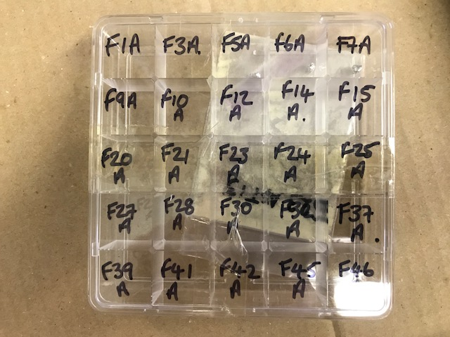
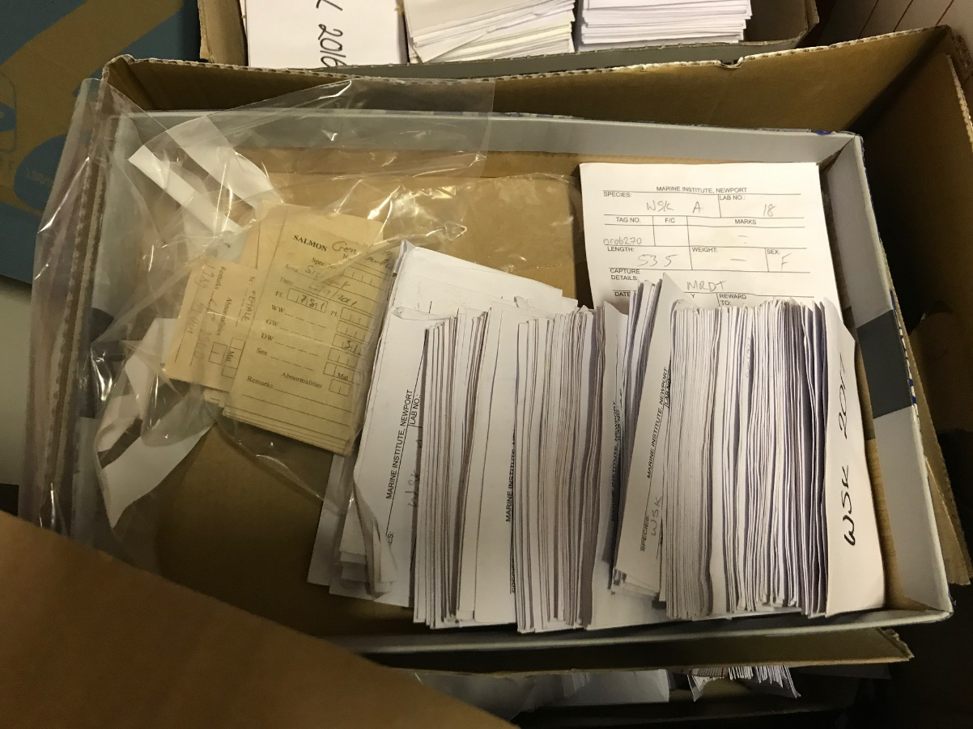
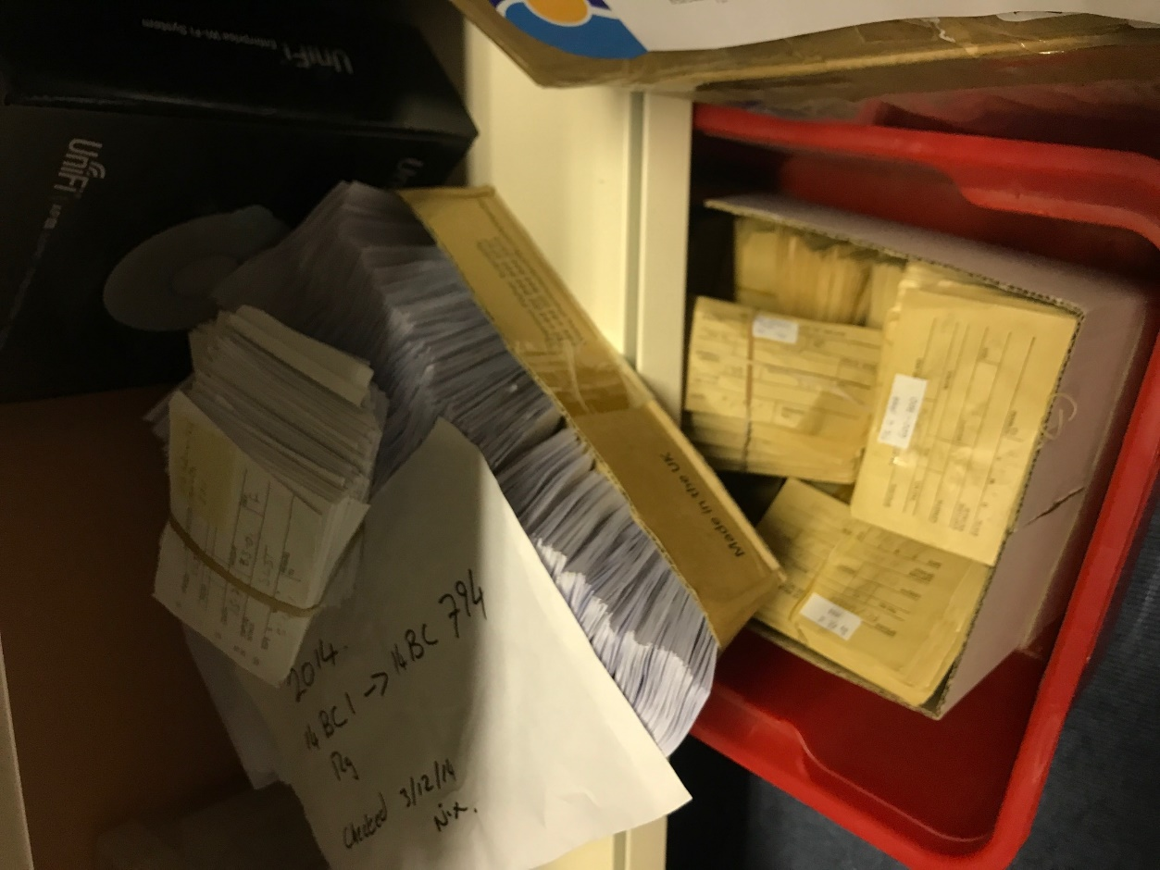
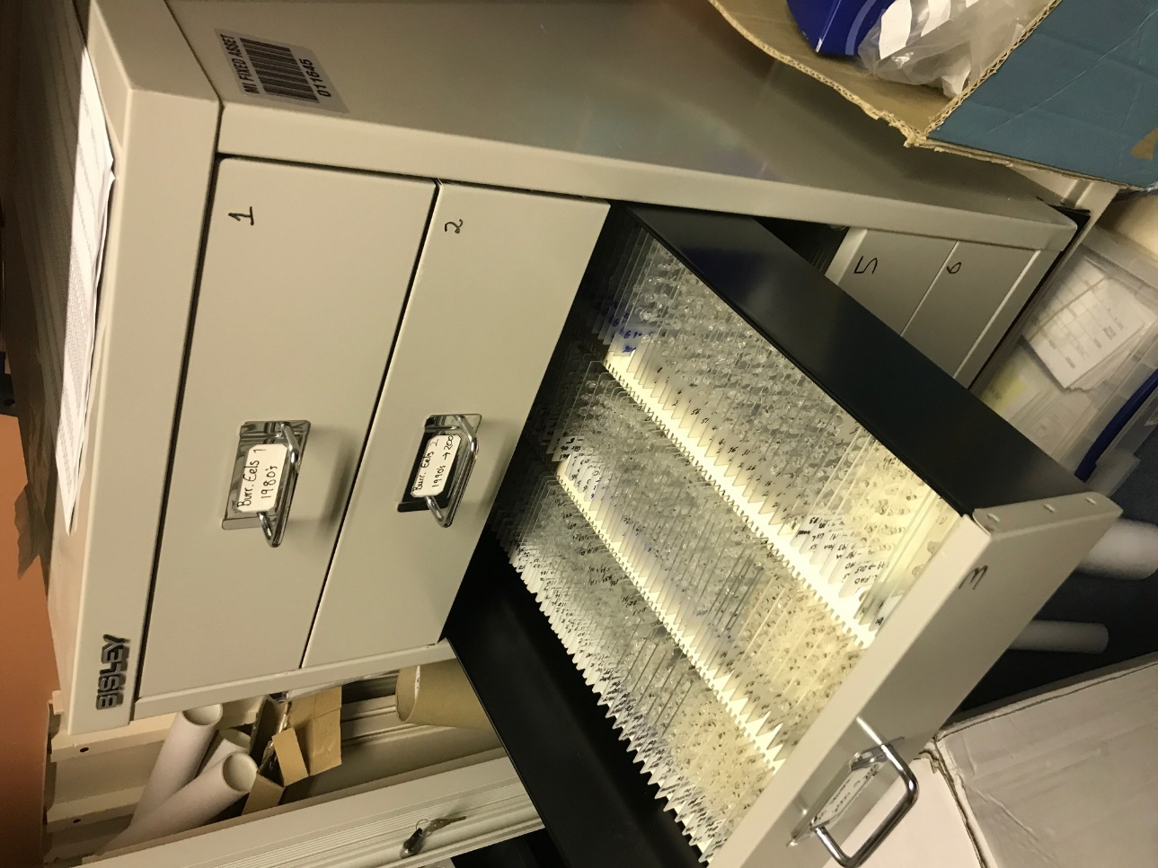
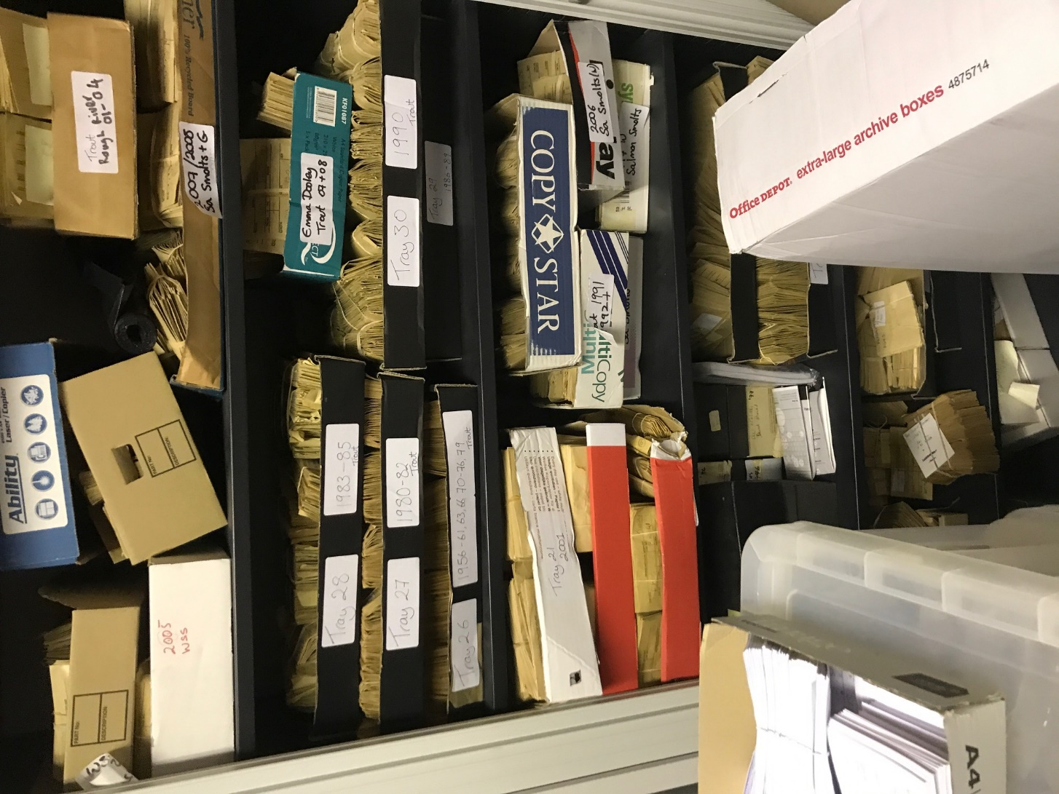
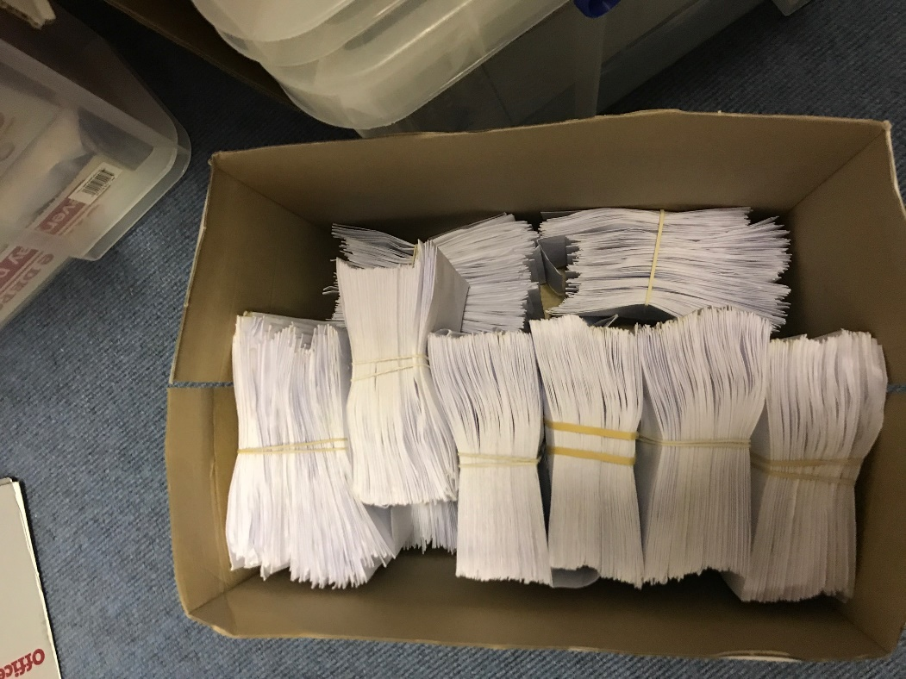
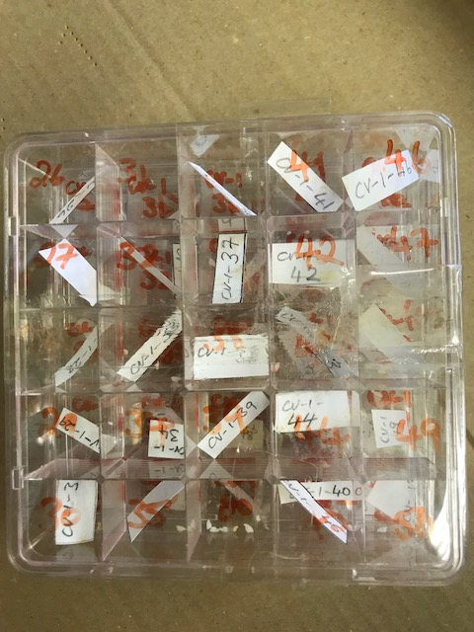
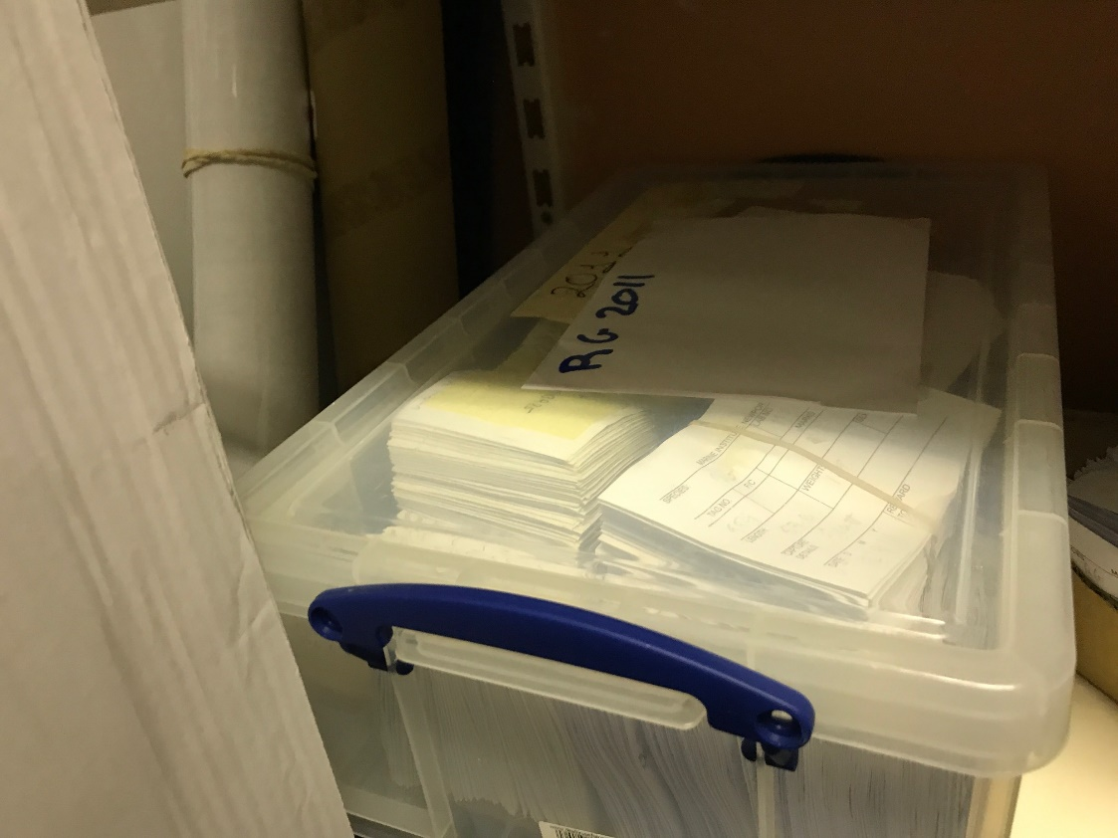
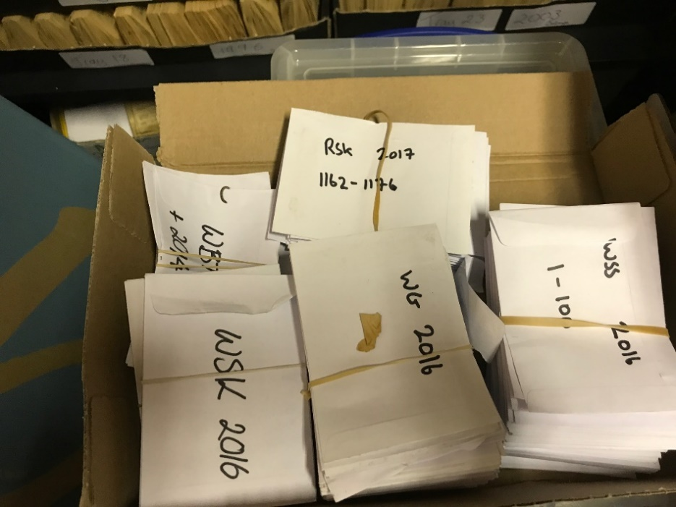
A. The Collection

Slide 25
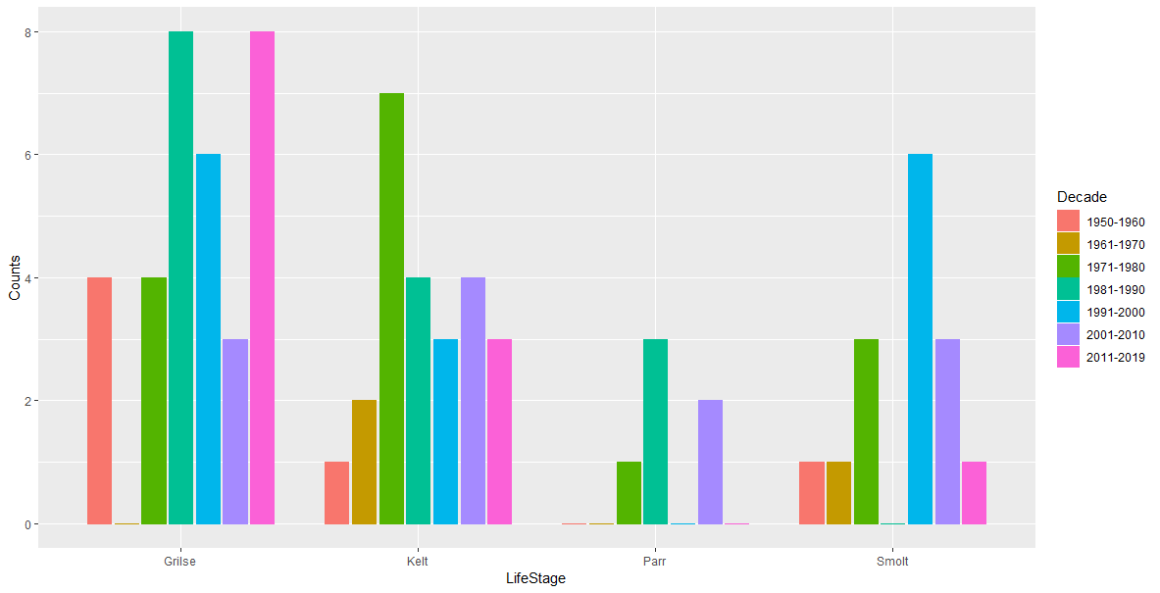

Slide 26
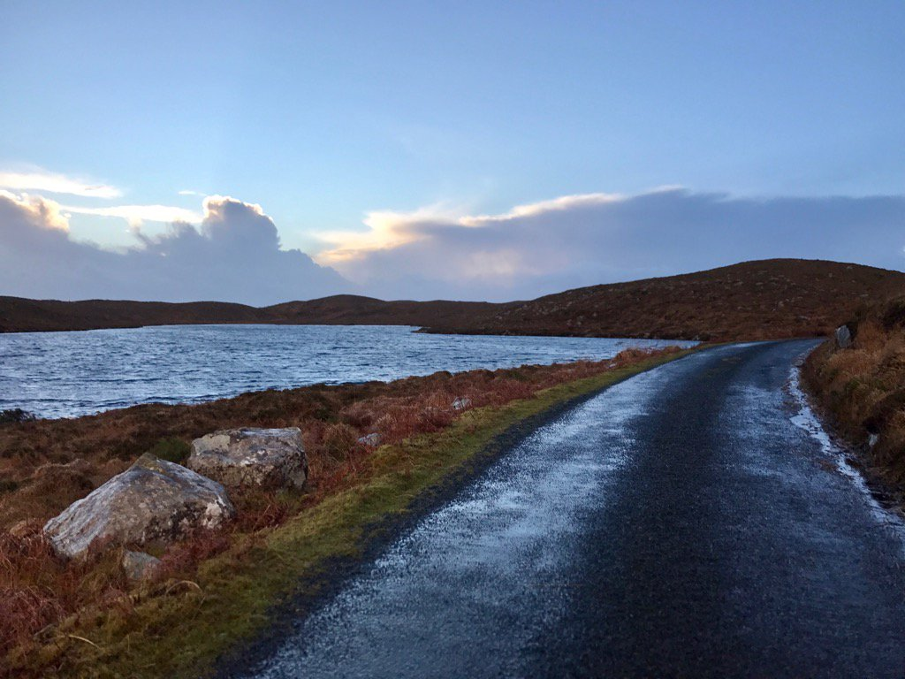
WP1 Deliverables
Sample Repository
Samples & Image Database
Elizabeth Tray

Slide 27
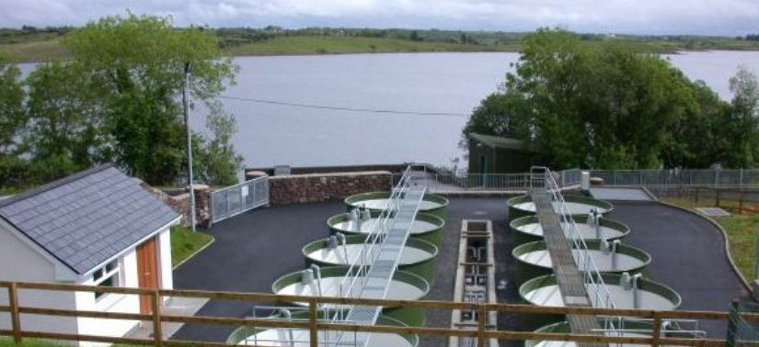
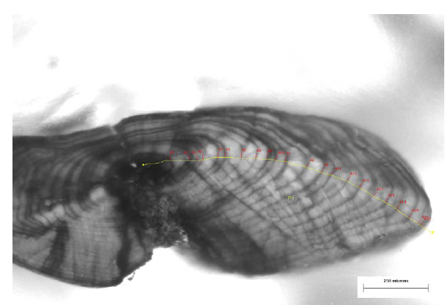
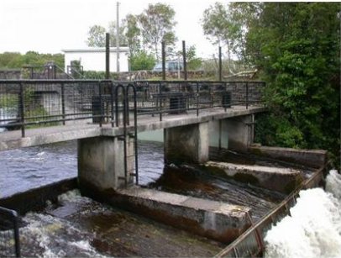
WP2 Summary
Using advanced statistical methods to model biological responses to catchment and oceanic change
Dr Louise Vaughan

Slide 28

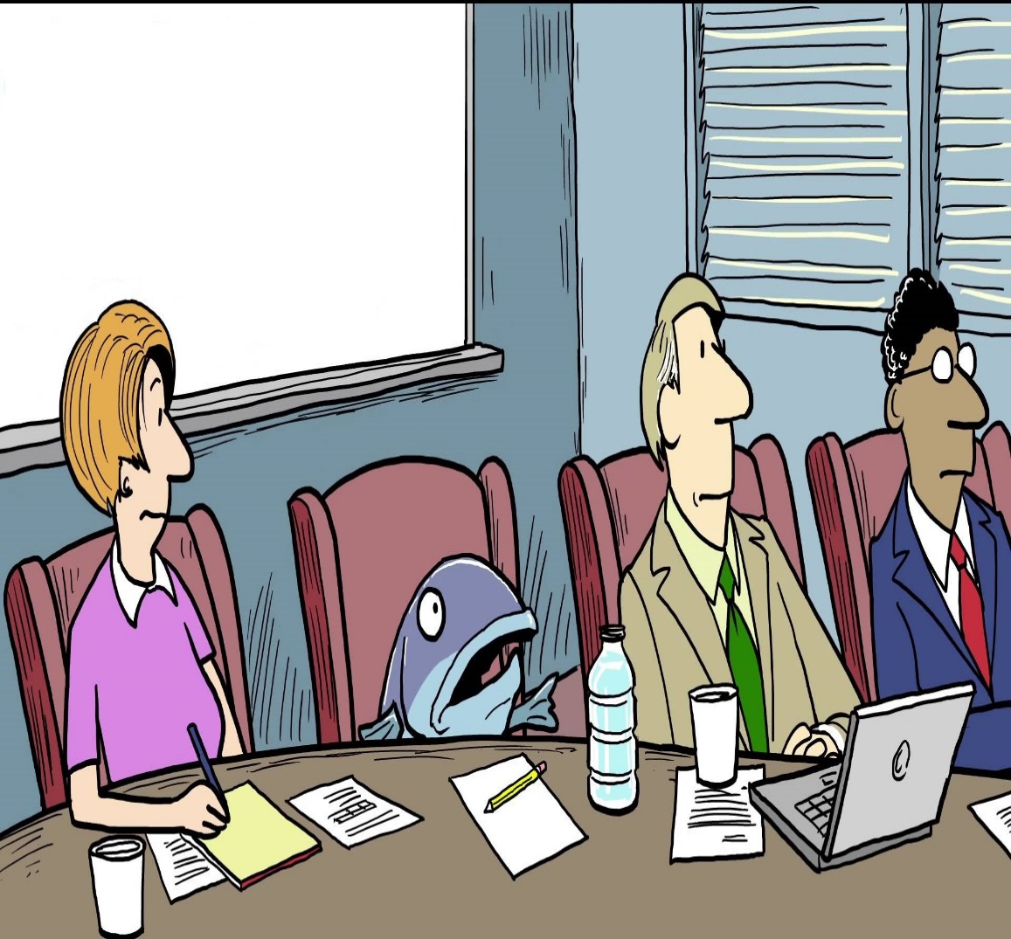
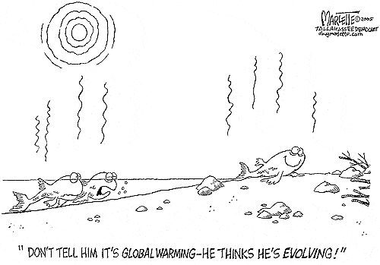
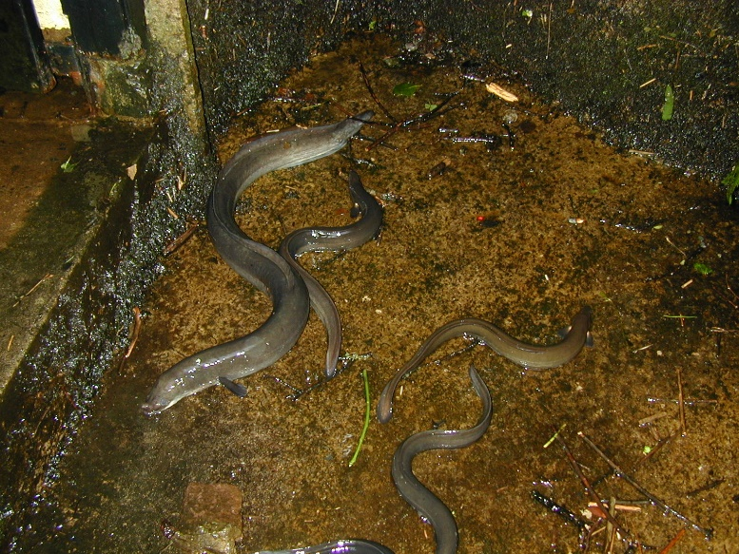
WP 2 Deliverables
Capacity Building and Method Development
Use scale growth trajectories from Atlantic Salmon to investigate declines in marine growth and survival and potential climate impacts
Relating patterns in annual growth increments of European Eel to temperature, productivity and meteorological conditions within the Burrishoole catchment
Exploration of management implications
© https://spollack.wordpress.com/category/editorial-cartoons-and-questions/
© http://www.pewtrusts.org

